Slide 1
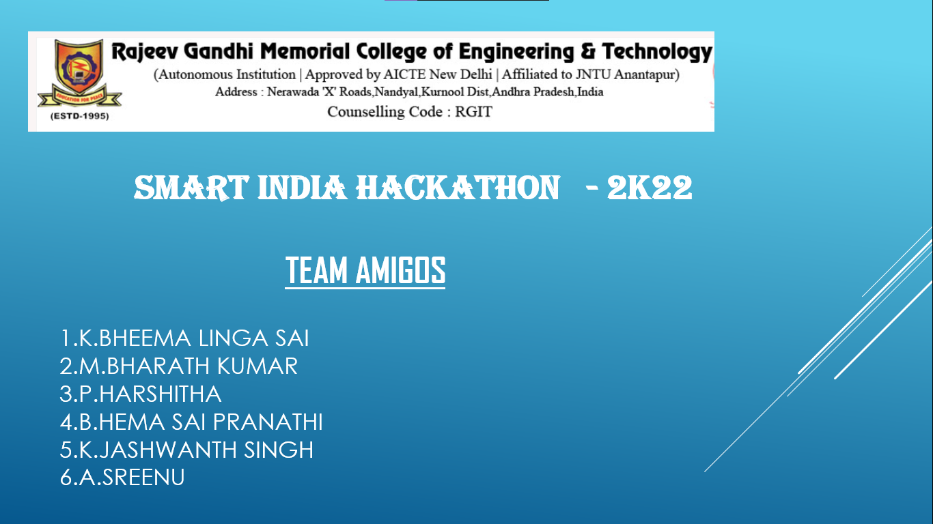

Slide 2
Contents
Objectives
Reports
Existing system
Disadvantages of Existing system
Proposed system and its working
Advantages of Proposed system

Slide 3
Objectives
Tracking of food waste.
Implementing it for better productive usage.
To take a initiative towards digital India.

Slide 4
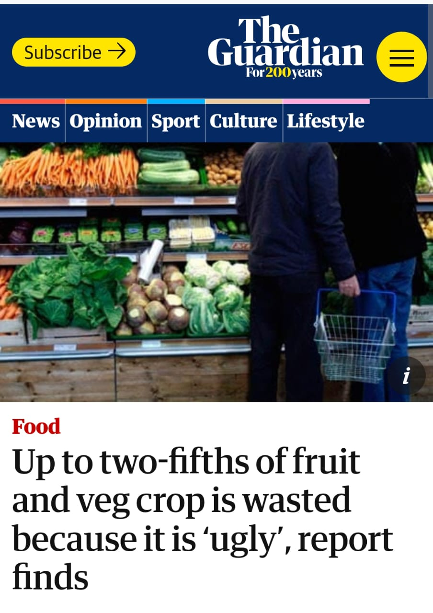
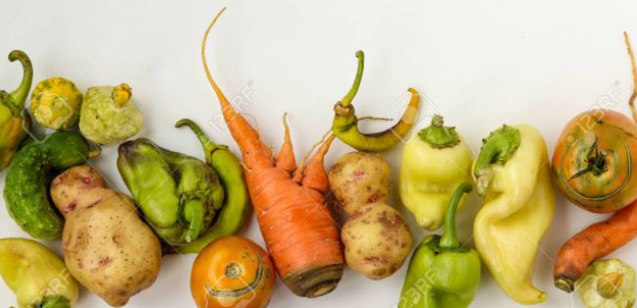
Reports
Food wastage due to its Appearance

Slide 5
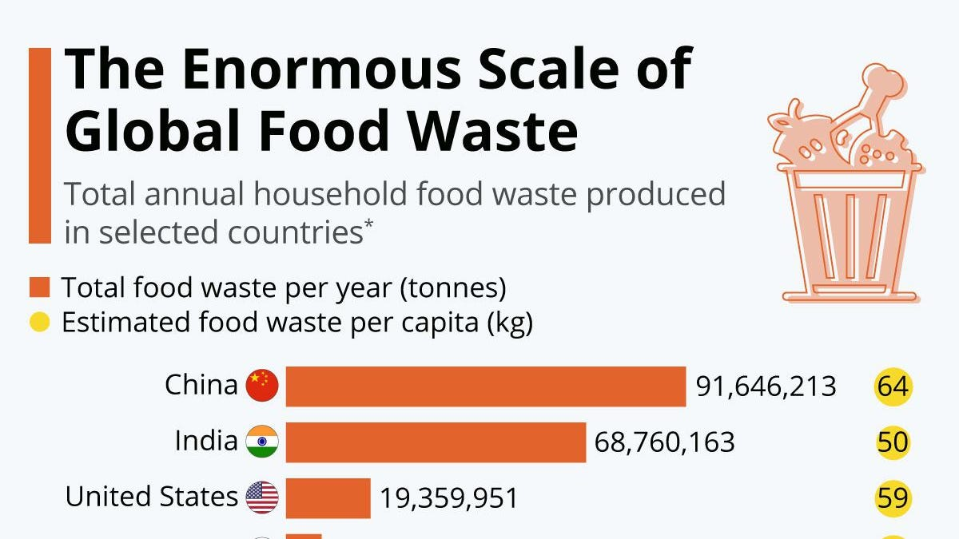

Slide 6
Existing System
No food waste – ( Donor and volunteer )
Y waste – Reduce food waste
Karma – save food with tap

Slide 7
Disadvantages of existing system
Difficulties in Functionality
Business models
Involves flow of money
Inefficient system

Slide 8


Proposed system and its working
We introduce an app, which implements tracing of the food waste for more productive usage.
Any one can use this app to give information about the food waste like availability, quantity, location, contact information of that person.
Now our app traces the nearby organization for the productive usage of that particular food.

Slide 9

Consists of options :
1. Left overs food :
When leftovers food option is selected , the app directs to the nearby municipalities or dump yards. Making a complaint on waste. So that they make appropriate move and store it for making organic composts , or store it for production of bio-fuels.

Slide 10


2. Improper shaped food :
This food option sends the message to the nearby respective organizations such as Old age homes, Orphanages .
So that they can increase their food storages.

Slide 11
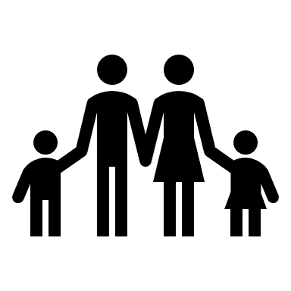
3. Retailed products
(Untouched food)
People can use this option , so that they can help fill the stomachs of other people.
Nearly about 22% of the people in India who are below poverty line are going to bed without proper food.

Slide 12
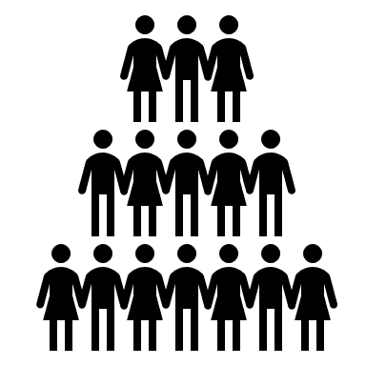
4. Food Philanthropy :
People can also think of food philanthropy option and let others to know about it in advance , so that they can make a move in advance and the food would also be edible.
It even promotes Humanity.

Slide 13
Advantages of proposed system
No such app has been introduced in app store and play store till date.
Simple
Doesn’t involves flow of cash
Clean and green
Reliable one

Slide 14
Thank you

